Slide 1
BBM 384
Software Engineering Lab, Spring 2018
Week 3&4
T.A. Bahar GEZİCİ

Slide 2
Introduction
Purpose
The aim of this exercise is to analyze the requirements of a given system and draw three UML diagrams in the requirements phase. (Context , use case, and activity diagrams).
The hospital management system (HMS) is designed for Any Hospital to replace their existing manual, paper based system. It is a large system including several subsystems or modules providing variety of functions. The new system is to control the following information; patient information, bed availability, appointment and admission schedules, file operations and etc. These services are to be provided in an efficient, cost effective manner, with the goal of reducing the time and resources currently required for such tasks.

Slide 3
Scope
Can be used in any Hospital or Clinic for maintaining patient details and their test results.

Slide 4
Problems with conventional system
Lack of immediate retrievals
Lack of immediate information storage
Lack of prompt updating
Error prone manual calculation
Preparations of accurate and prompt reports

Slide 5
Advantages of HMS
Immediate Access of data
Friendly user interface
Time saving
Saving paper work

Slide 6
Requirements
Hospital Receptionist schedules patient's appointments and admission to the hospital, collects information from patient upon patient's arrival and/or by phone. For the patient that will stay in the hospital ("inpatient") she or he should have a bed allotted in a ward. Receptionists might also receive patient's payments, record them in a database and provide receipts, file insurance claims and medical reports.
Hospital Doctor performs patient examination and views test results.
Patient can view his/her test results.
Laborant can do tests, view test reports and send them to doctor and receptionist.

Slide 7
Diagrams
Types of Diagrams
Context diagram
Use Case diagram
Activity diagram

Slide 8



Context diagram
The Context Diagram shows the system under consideration as a single high-level process and then shows the relationship that the system has with other external entities (systems, organizational groups, external data stores, etc.).
The elements can be;
Process
External entity
Data store
Connector

Slide 9
Use case Diagram
Use case diagrams model behavior within a system and helps the developers understand of what the user require. The stick man represents what’s called an actor.
Use case diagram can be useful for getting an overall view of the system and clarifiying who can do and more importantly what they cant do.
Use case diagram consists of use cases and actors and shows the interaction between the use case and actors.
The purpose is to show the interactions between the use case and actors.
To represent the system requirements from user’s perspective.
An actor could be the end-user of the system or an external system.

Slide 10
Activity diagram
An activity diagram visually presents a series of actions or flow of control in a system similar to a flowchart or a data flow diagram
The components can be;
Initial node
Activity final node
Action
Decision node

Slide 11
Purpose 1
Draw the context diagram of HMS.

Slide 12
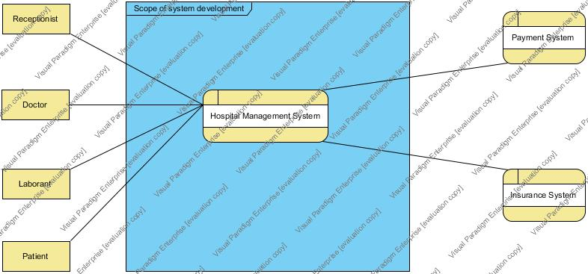
Figure 1. Context diagram of HMS

Slide 13
Purpose 2
Describe major services provided by a hospital's reception, doctor, patient and laborant by using Use Case diagram. Shows actors, use cases and relations in your diagram.

Slide 14
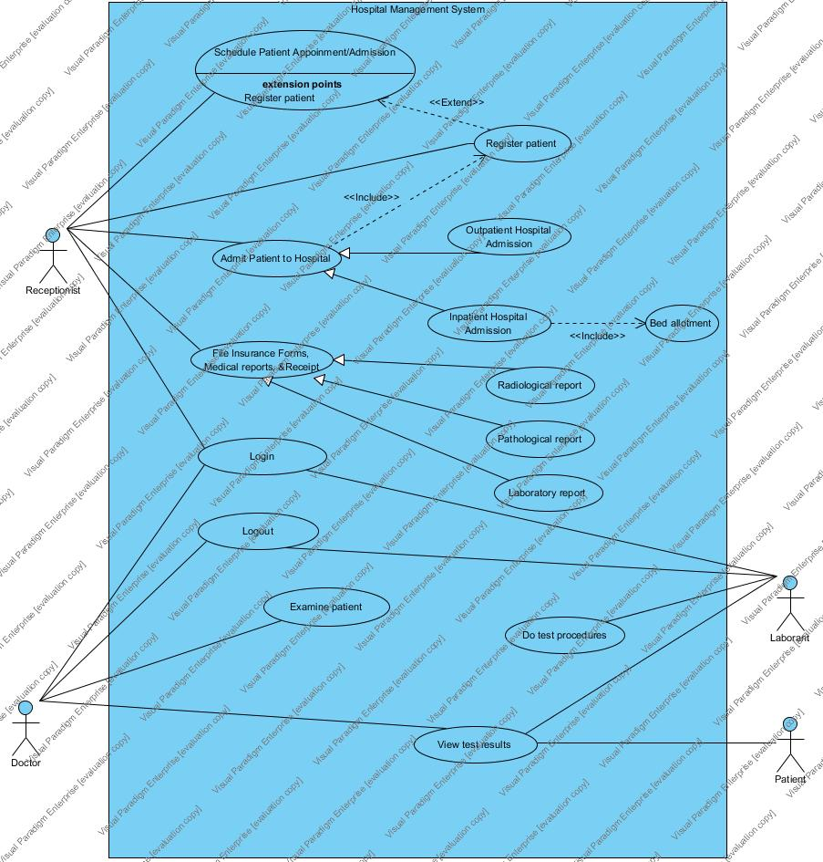
Figure 2. Use case diagram of HMS

Slide 15
Purpose 3
Draw the activity diagram of the doctor's examination process for outpatient.

Slide 16
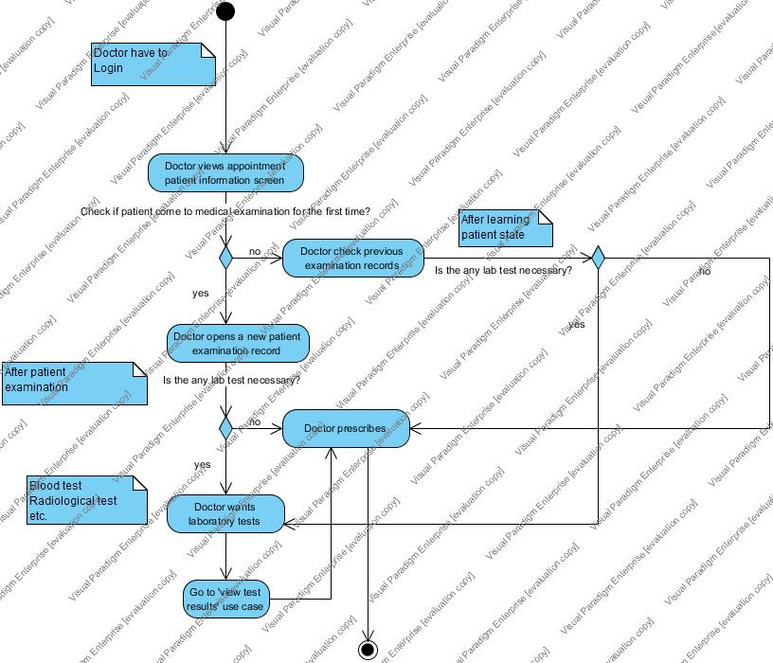
Figure 3. Activity diagram of patient examination

Slide 17
Purpose 4
Write tabular descriptions of Patient Examination use case.

Slide 18
Purpose 4
Structured Natural Language
The requirements are written using numbered sentences in natural language.
Only outside behaviour of the systems as observed by the user(s).
Use case:
Actors
Pre-condition
Post-condition
Main (happy) path:
Alternative path:

Slide 19
Use case: Examine patient
Actors | Doctor
Pre-condition | Appointment patient screen is not opened.
Post-condition | Appointment patient screen is opened.
Main (happy) path: | 1-Doctor views the appointment patient information screen 2-Doctor opens a new patient examination record 3-After examination, doctor prescribe.
Alternative path: | 1-After examination, if laboratory procedures are necessary, doctor wants laboratory tests 2-Doctor views test results of the patient 3-continue with step-3 in main path
Table 1. Tabular description of patient examination

